Slide 1
A Collision Warning System for the Insitu Common Open-mission Management Command and Control (ICOMC2) System External Demo Sprint 1405
May 2, 2014

Slide 2
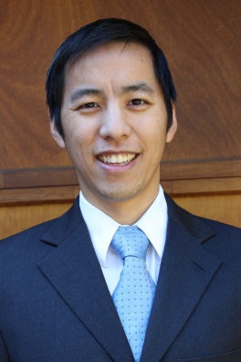
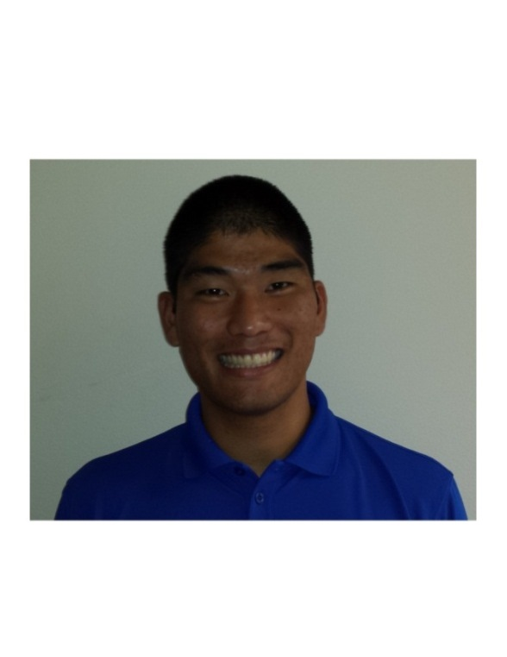
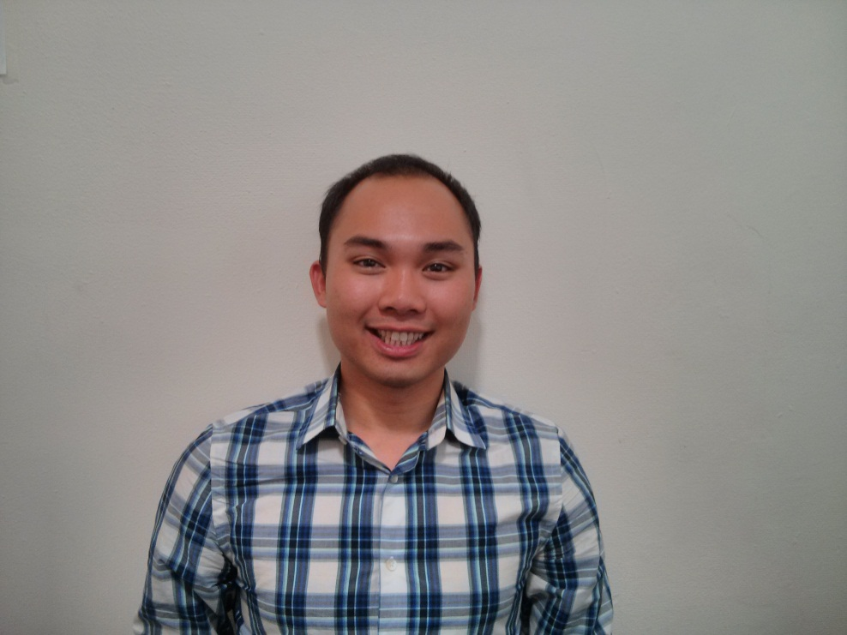
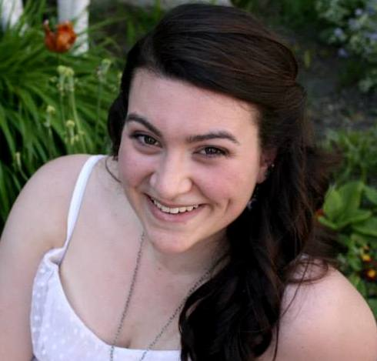
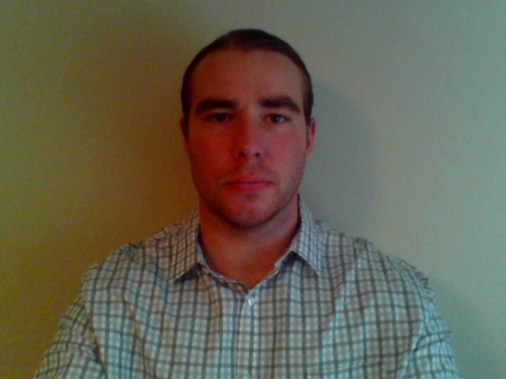
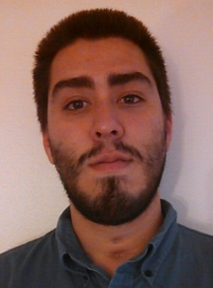
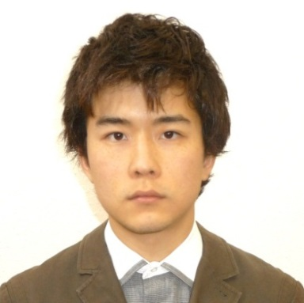
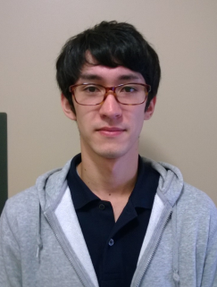
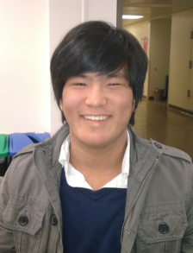


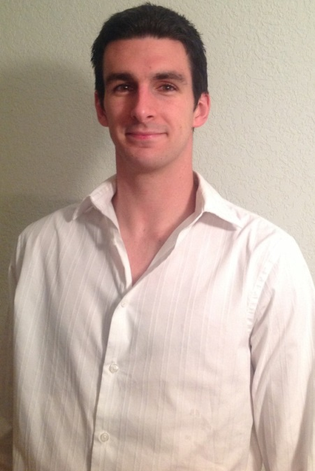
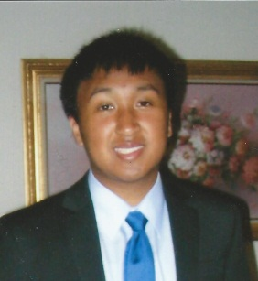
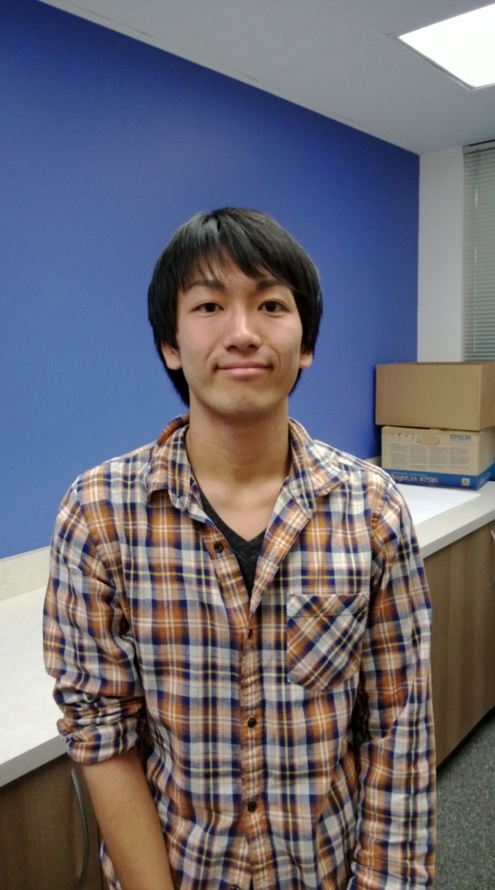
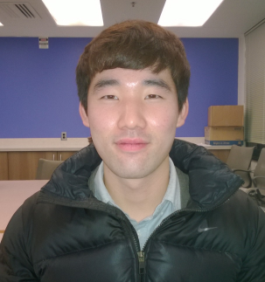
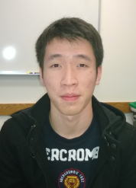
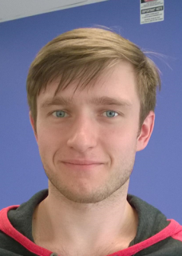
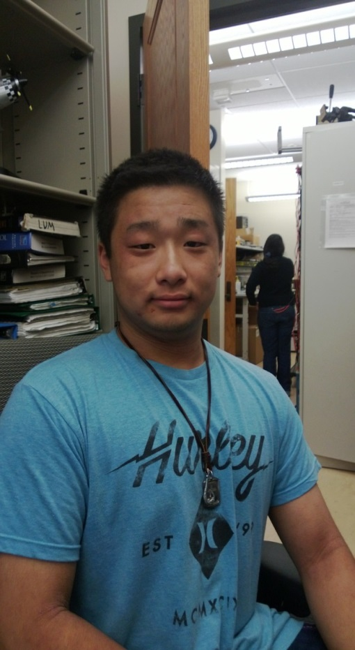
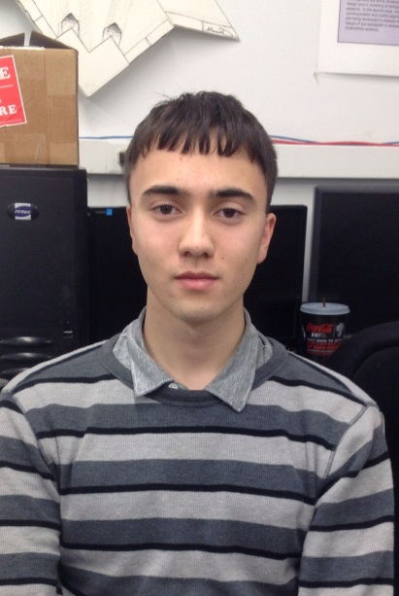
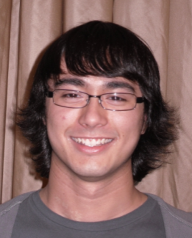
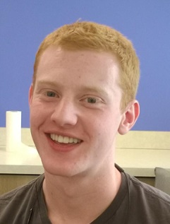
Team Introduction
Christopher Lum
Research Scientist
Lt. Kevin Ueunten
Masters Student
Bao Le
Masters Student
Madison Peck
BS Alumni
Matt Davis
Senior
Federico Alvarez
Senior
Noel Kimber
Senior
Dai Tsukada
Senior
Richard Fukutome
Senior
Taylor Campbell
Senior
Robert McSwain
Senior
Al Creigh
Junior
Daniel Ablog
Junior
Keisuke Tsujita
Junior
Seunghyun Ko
Junior
Brian Chang
Junior
Aleksandr Tereshchenkov
Junior
Henry Qin
Sophomore
John Marshall
Sophomore
Justin Yantus
Sophomore
Ryan Valach
Sophomore
University of Washington
2

Slide 3
User Story Overview
ICOMC2 CAPlugin Team
 | Committed Stories |  | Stretch Stories
 | Number of Stories | Total Story Points | Number of Stories | Total Story Points
Accepted Status | 16 | 49 | 0 | 0
Descoped Status | 10 | 33 | 18 | 69
Impeded Status | 7 | 21 | 0 | 0
Total: | 33 | 103 | 18 | 69

Slide 4
User Story Progression
1309 | 1310 | 1311 | 1312 | 1313 | 1401 | 1402 | 1403 | 1404 | 1405 | 1406 | 1407
Many seniors are working on senior design projects.
Shifting resources away from CA Plugin project to other efforts.

Slide 5
241 – Gaussian Random Number Generator
Development Champion: Henry Qin
Content
As an SQA engineer, I would like a class that can create a random number or vector which is sampled from a Gaussian distribution so that I can use it to run Monte Carlo simulations and to numerically test several classes.
Definition of Done
[X ] Review the definition of a 1D Gaussian/normal distribution.
[X ] Research if this functionality exists within the .Net 3.5 framework.
[X] If this functionality does not exist, create a random number generator which generates a random number sampled from a Gaussian distribution.
[X] Create unit tests for this class. Ensure that all unit tests pass.
[X] Add ability to sample from a 2D Gaussian distribution with a specified mean and covariance matrix.
[X] Add tests cases for 2D Gaussian distributions
[X] Integrate this into the UW solution

Slide 6
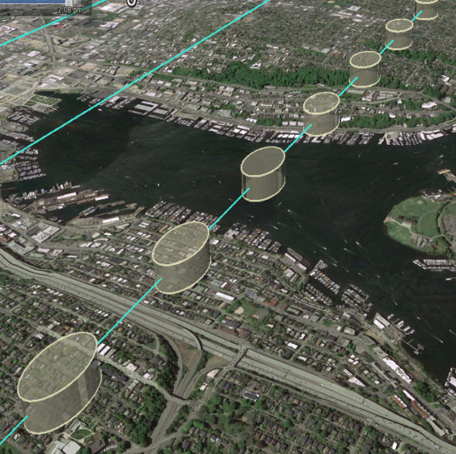
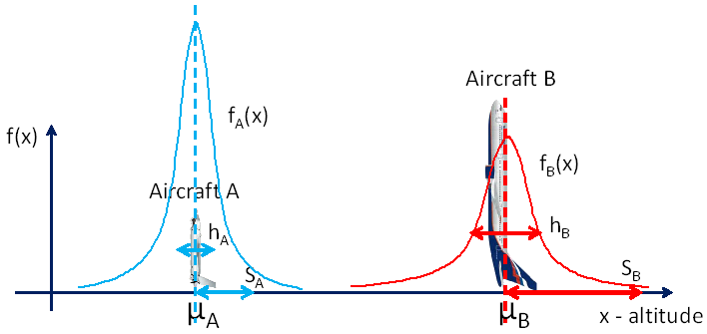
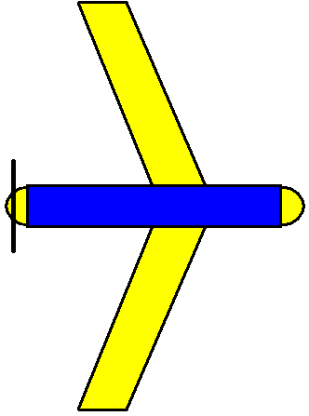
Purpose
Many of our prediction capabilities are based on Gaussian Distributions
Create a Generator that will generate random samples from a Gaussian distribution
1D Distribution
Extend to 2D
Run Monte Carlo simulation

Slide 7
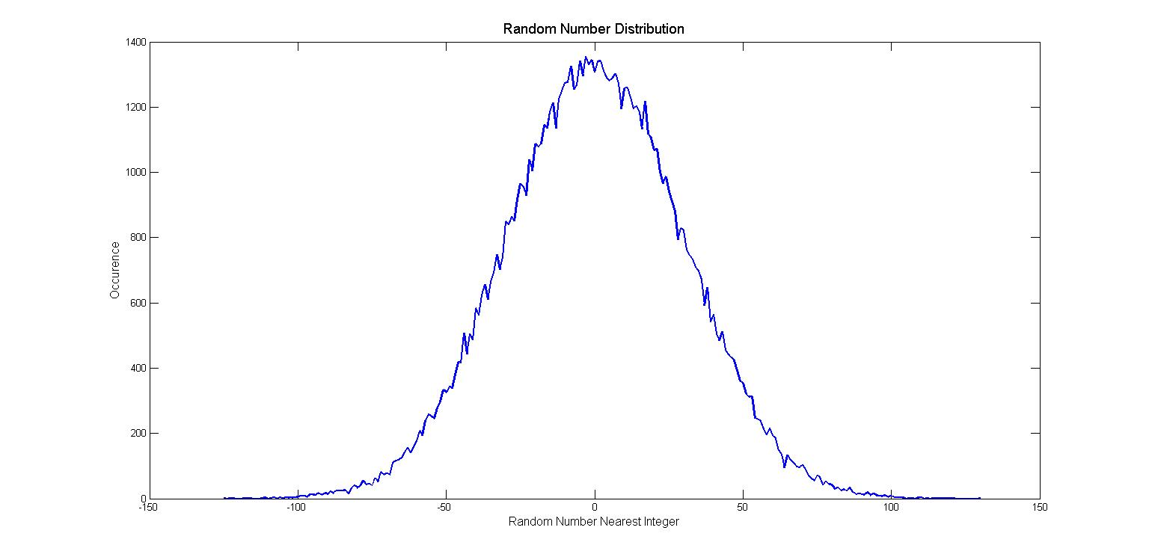
1D Distribution Example
1D Distribution
100,000 samples
Mean of zero
Standard Deviation of 30

Slide 8
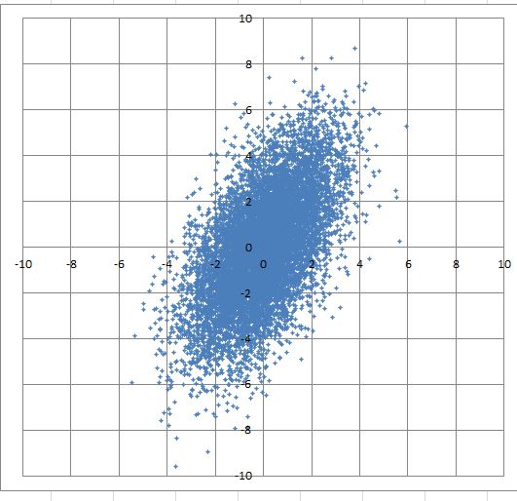
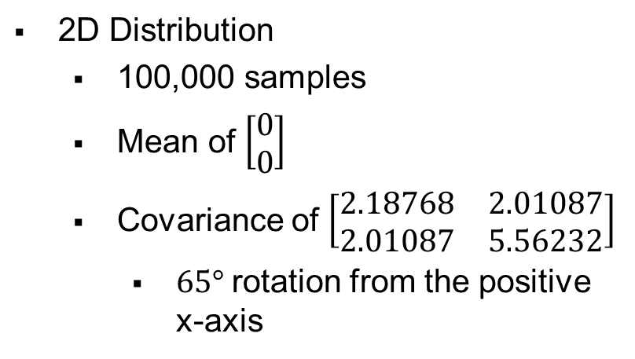
2D Distribution Example
2D Distribution
100,000 samples
Mean of $\left[\begin{matrix}0 \\ 0\end{matrix}\right]$
Covariance of $\left[\begin{matrix}2.18768 & 2.01087 \\ 2.01087 & 5.56232\end{matrix}\right]$
$65°$rotation from the positive x-axis

Slide 9
189 – Forward State Estimator Implementation (Orbit)
Development Champion: Kevin Ueunten
Content
As a software developer, I would like a software algorithm/entity to perform the forward state estimation of an aircraft engaged in an orbit so that I can use it within the plugin.
Definition of Done
[X] Review a prototype/proof-of-concept algorithm in Matlab (see user story 027)
[X] Implement select features outlined in the Feature Level Design (user story 003 – Forward State Estimator Feature Level Design). These should include
[X] Ability to estimate the future state of the aircraft which is engaged in an orbit.
[X] Address requirements 2.1.2
[X] Address requirements 2.2.1
[X] Implement code in in UW.sln
[X] Design scenarios showing an aircraft in free flight and the estimator calculating the future state of the aircraft.
[X] Create diagrams, pictures, or movies illustrating how this component works (these can be shown at a demo).
[X] Ensure that unit test for all public methods are written and pass (work with an SQA engineer to do this, you do not need to write these yourself)
[X] Document/comment all public interfaces.

Slide 10
Overview
Forward State Estimator (FSE)
FSE Orbit
Overview
Example
Future work

Slide 11
Forward State Estimator
Predicts aircraft’s future position based on a stochastic process, assuming a Gaussian distribution
Provides aircraft’s mean position and the associated covariance / variance at a future time
FSE results are used to calculate collision probabilities
Supports 3 flight modes: free flight, orbit and flight path

Slide 12
FSE Orbit
Orbit mode: an aircraft flying in an orbit
Known aircraft variables:
Aircraft position
Aircraft velocity
GPS error (altitude and planar)
Speed error
Climb angle error
Heading angle error
Orbit center
Orbit radius
Orbit direction
Using these known variables the covariance and variance is calculated using second order error propagation techniques

Slide 13
FSE Orbit (Cont.)
Controls the variance and covariance to give reasonable results
Handles edge case scenarios (to include but not limited to):
Aircraft not initially on the orbit but on the same altitude
Aircraft not initially on the orbit but on a different altitude
Aircraft on the orbit but on a different altitude

Slide 14
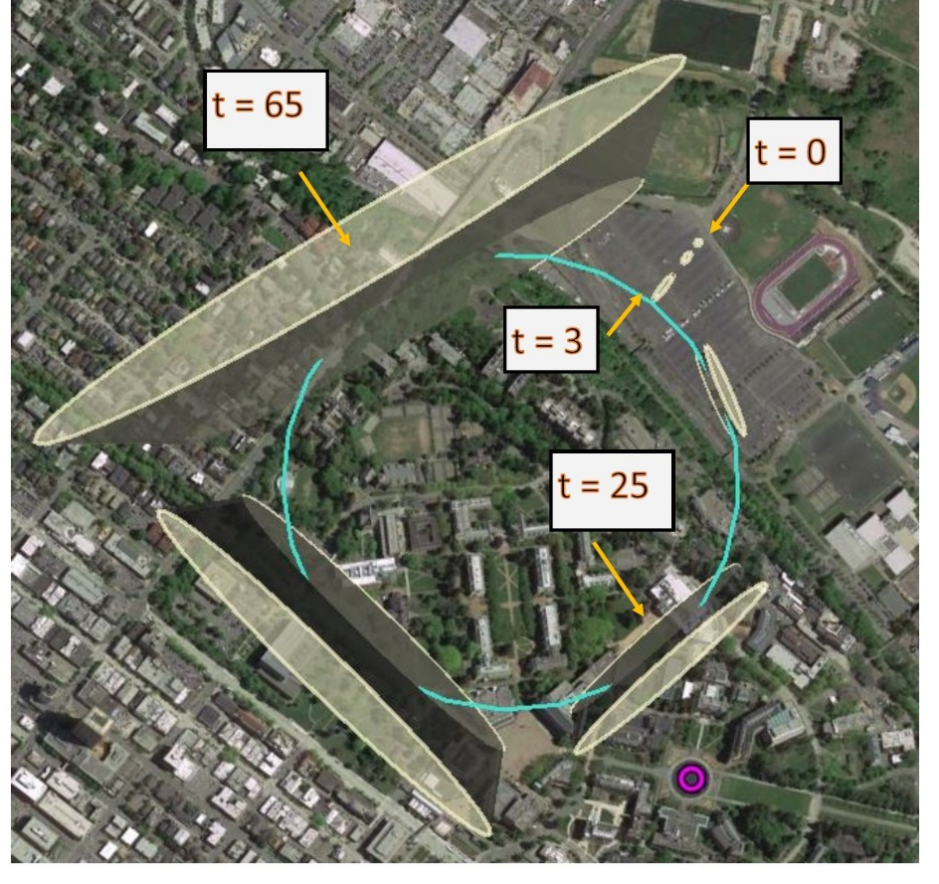
FSE Orbit Example 1
Aircraft begins outside the orbit, enters the orbit, and then flies clockwise around the orbit. Furthermore the aircraft’s initial altitude is the same as the orbit’s altitude. The future predictions have a 95% confidence level.
This is a top view of the FSE orbit results.

Slide 15
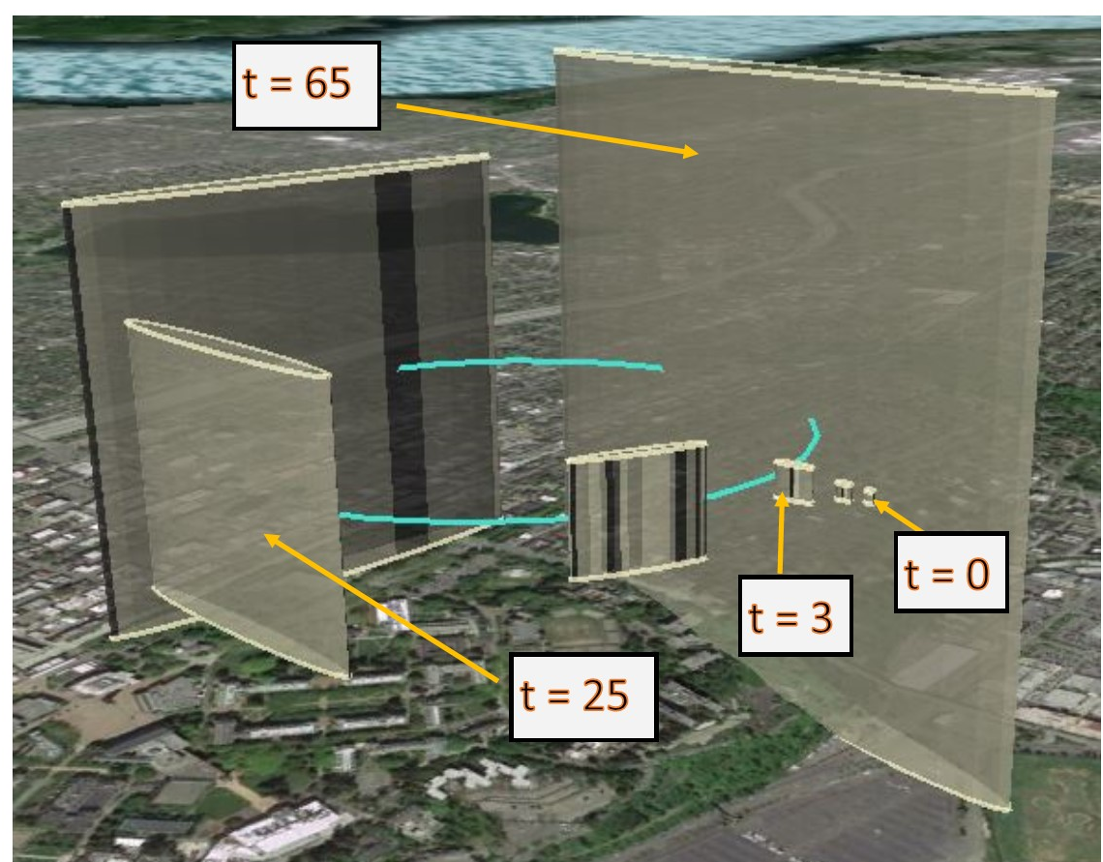
FSE Orbit Example 1 (cont.)
Aircraft begins outside the orbit, enters the orbit, and then flies clockwise around the orbit. Furthermore the aircraft’s initial altitude is the same as the orbit’s altitude. The future predictions have a 95% confidence level.
This is a side view of the FSE Orbit results.

Slide 16
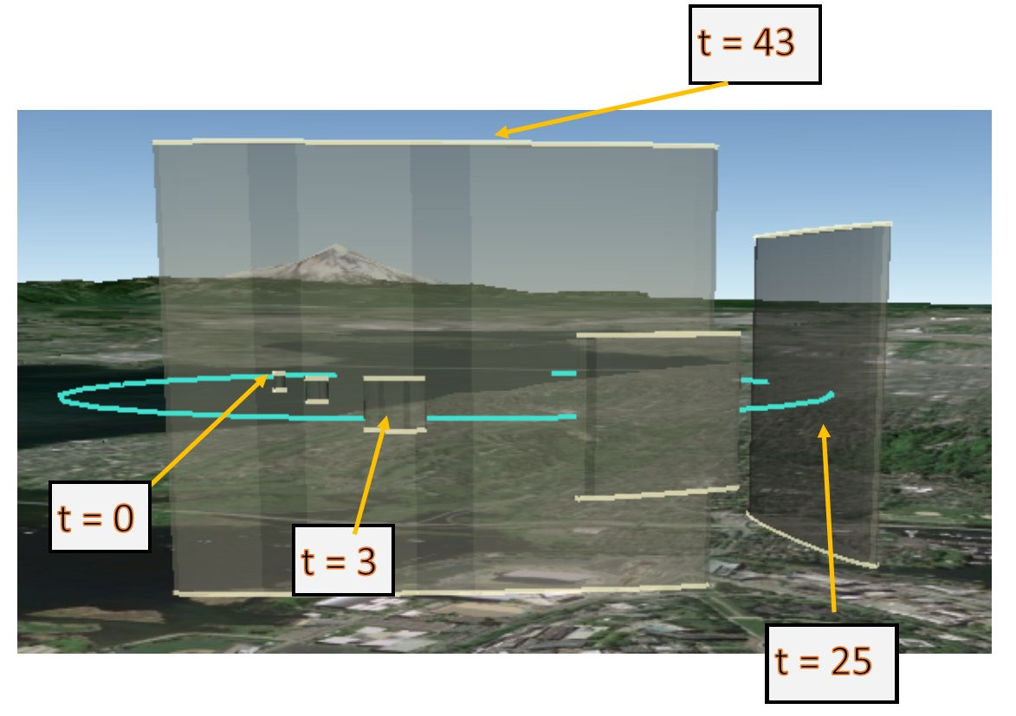
FSE Orbit Example 2
Aircraft is on the orbit but starts at a different altitude, then it will descend to the correct altitude and fly counter clockwise around the orbit. The future predictions has a 95% confidence level.
This is a side view of the FSE Orbit results.

Slide 17
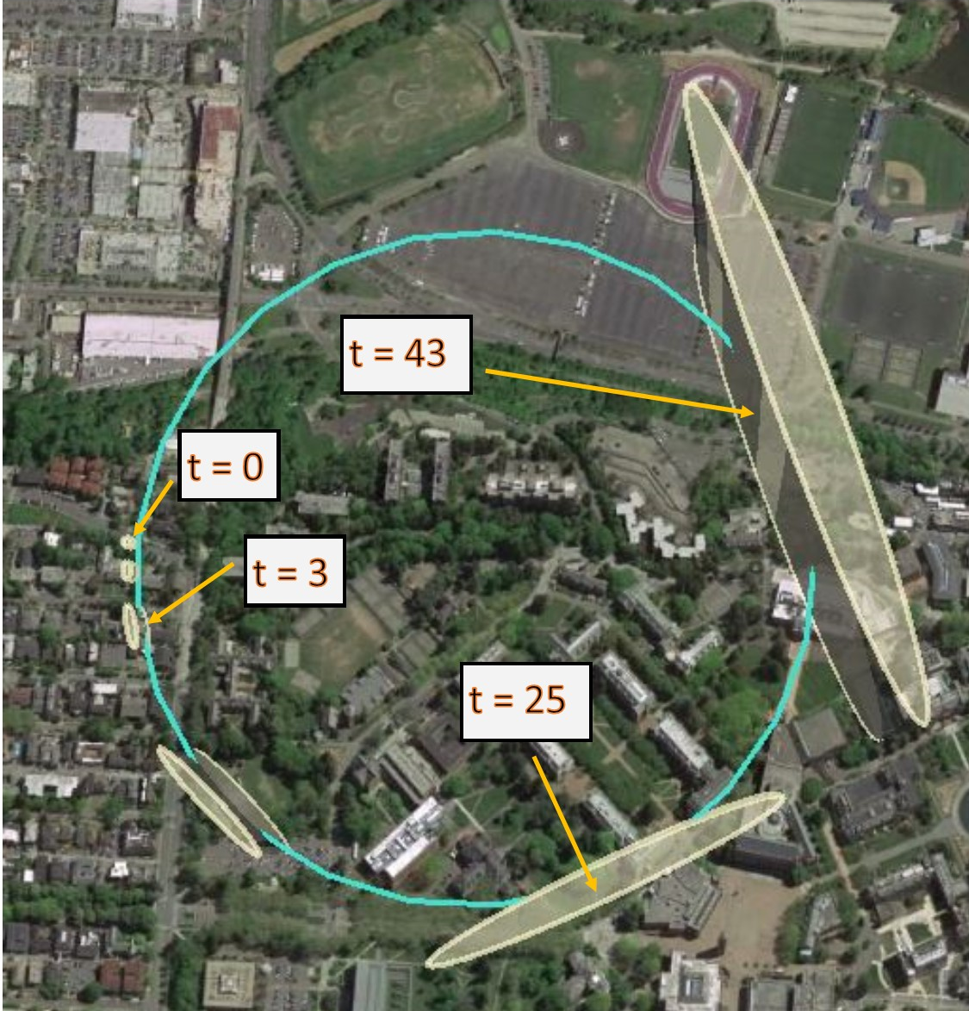
FSE Orbit Example 2 (cont.)
Aircraft is on the orbit but starts at a different altitude, then it will descend to the correct altitude and fly counter clockwise around the orbit. The future predictions has a 95% confidence level.
This is a top view of the FSE orbit results.

Slide 18
Future work
Determine more realistic variance in the altitude and along the tangential portion of the orbit
Demonstrate complicated scenarios with other flight modes and airspaces

Slide 19
253 – 3D Volume Restricted Airspaces Implementation (Method 1)
Development Champion: Christopher Lum
Content
As a software developer, I would like to develop a class to represent 3D restricted airspaces so that I can use it within the plugin in conjunction with other modules such as the conflict calculator.
Definition of Done
[x] Coordinate with Chris Lum to discuss 3D volume restricted airspace.
[x] Create a class to represent a 3D volume (polyhedron). This class should support
[x] Hit detection (user can specify a point and class can determine if this is inside the polygon)
[x] Determine if it is well formed (ie not complex)
[x] Class should implement the IHittableCopyable interface
[x] Create a separate project outside of the UW.sln to illustrate how these can be used to compute the probability of ConflictEntity entering this polyhedron (see user story ‘255 –Integration of Position Probabilities Over An Arbitrary Volume’).
[x] Coordinate with Chris Lum to discuss results.

Slide 20
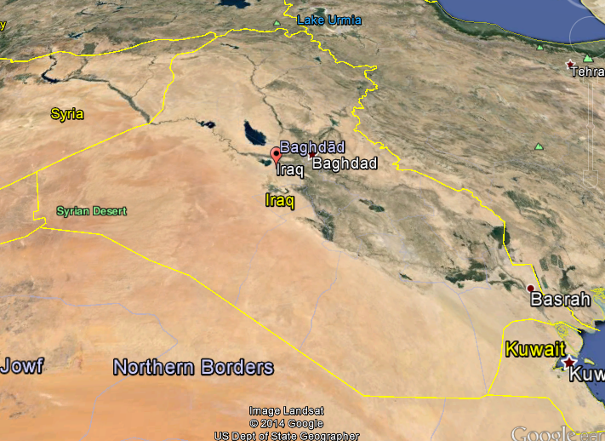


3D Restricted Airspaces
Non-complex, non-convex polygon defined in the XY plane.
Height and Z-centroid independently defined and used to “extrude” polygon to third dimension.
Polygon supports hit detection.
User can select an annotation layer then define min/max active altitudes

Slide 21
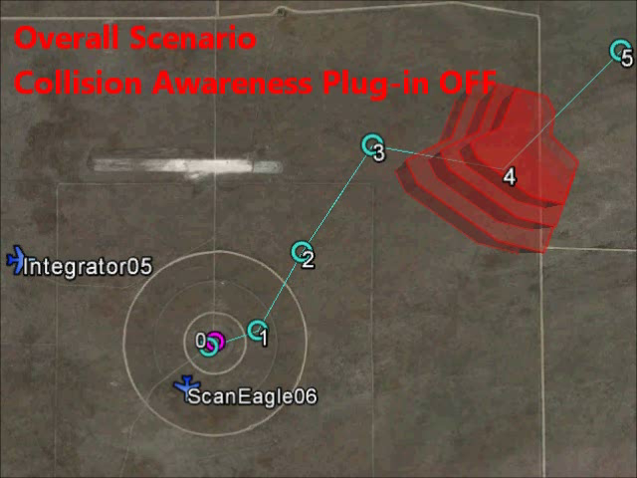
Overall Scenario

Slide 22
Conflict Types
System supports 3 types of conflicts
Type 1: What other aircraft will breach perspective entity’s airspace?
Selfish
“Who is going to hit me?”
Type 2: Will perspective entity breach any other aircrafts’ airspaces?
Selfless
“Who am I going to hit?”
Type 3: Will perspective entity breach any other restricted airspaces?
Only used for conflicts with airspaces.

Slide 23
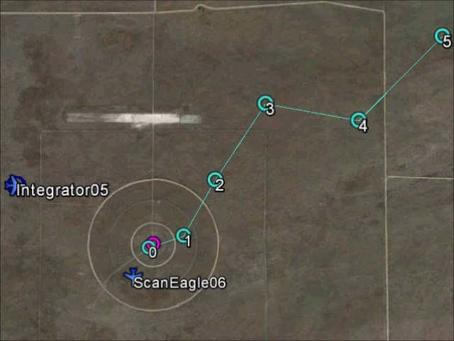
Type 2 Conflicts
Other entity’s worse case airspace volume
High probability that at future time, perspective entity will breach other entity’s airspace

Slide 24
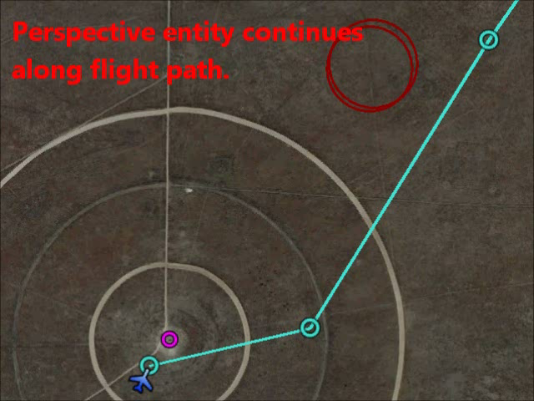
Type 2 Conflicts

Slide 25
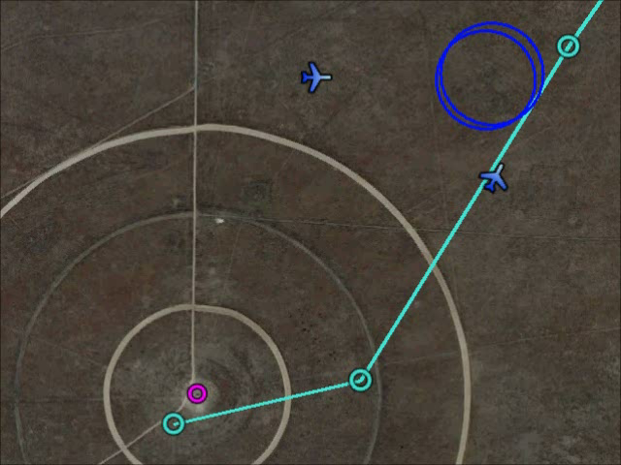
Type 2 Conflicts

Slide 26
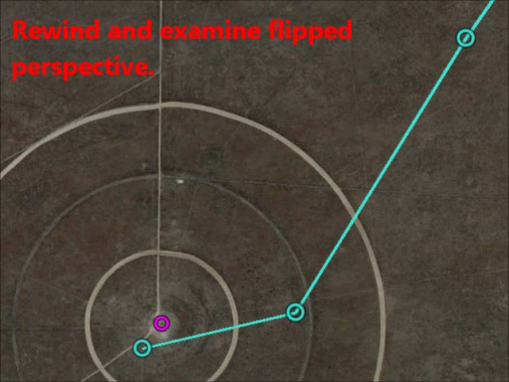
Type 1 Conflicts

Slide 27
Conflict Types
Operator does not want to keep track of what type of conflict the system encounters.
CA Plug-in provides a simple “worse case” analysis.

Slide 28
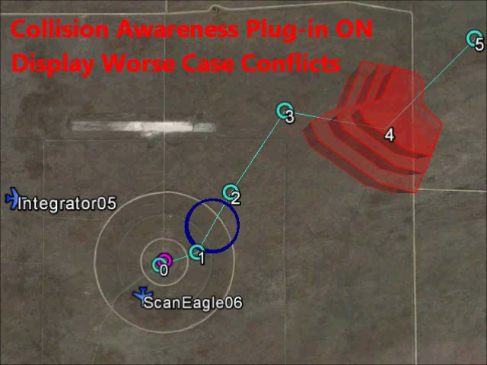
Worse Case Conflicts

Slide 29
261 – JCATI Symposium Trip Logistics 216 – JCATI Symposium Research Poster 1 217 – JCATI Symposium Research Poster 2
Development Champion: John Marshall, Al Creigh, Taylor Campbell
Content
As a project participant, I would like to create a poster about our work so that I can present our research at the annual JCATI Symposium in Pullman, WA.
Definition of Done
[x] Coordinate with Chris Lum to discuss content for this poster.
[x] Coordinate with Al Creigh to get the template of the poster.
[x] Come to a consensus on poster dimensions
[x] Data mine existing documents to obtain graphics, equations, verbiage, etc.
[x] In the UW.sln
\\UWSDK\UWCAPlugin\ConflictCalculator\Entities\PlanarConflict\Notes\PlanrConflict.nb
[x] Bao Le’s master thesis (UserFiles\lebao000\masters_thesis )
-powerpoint
-pdf of the thesis
[x] Draft poster presented to group. Obtain and incorporate group feedback.
[x] Final poster printed and ready to go by April 14
[x] Talking points rehearsed and ready to present poster at symposium on April 21 (delegate this to the persons that will be presenting the poster).

Slide 30
Not Demoable Accepted User Stories
STORY ID | SIZE | DEVELOPMENT CHAMP
206 – Software Quality Assurance for Sprint 1402 (Position 3) | S | Brian Chang
219 – Unit Testing for Sprint 1403 | M | Brian Chang
226 – Unit Testing for Sprint 1403 | M | Ryan Valach
257 – Insitu Trip Wrap-Up | S | Justin Yantus
267 – Developer WebEx Account Setup (Group 16) | XS | Aleksandr Tereshchenkov
268 – Unit Testing Background Training (copy) | M | Aleksandr Tereshchenkov
272 – Unit Testing Background Training (copy) | M | Ryan Valach
274 – Sprint 1405 Administration | M | Christopher Lum
277 – Australia: Prototype Forest Fire-Line Identification System | L | Keisuke Tsujita
282 – Perforce Shelf Sets | S | Christopher Lum

Slide 31
Next Steps (Sprint 1406 Plans)
Continue unit testing all public API of existing code base.
Backend feature completion
Numerical integration of Gaussian distributions for airspace conflicts.
Simulation of all expected capabilities
Setup ICOMC2 2.0 Environment
Chris Lum to travel to Insitu ASAP to obtain development kit.
Students will be given access as clearance is granted.
Begin CAPlugin development within ICOMC2 2.0.
QUESTIONS?

